Slide 1



GOOGLE PLAY APPS
Xu, Ange
Dai, Zhongkai
Campeny, Eloi
Moure, Ximena
González, Victor
Chriki, Fatima Zohra
Multivariate Analysis ◇ Dec’22

Slide 2
TABLE OF CONTENTS
01
02
03
04
05
06
07
Problem definition
Previous study
Clustering
Profiling
Decision Trees
Discriminant Analysis
Conclusions

Slide 3
01
Problem definition

Slide 4


Problem definition
Analyze which factors can influence the rating of an app

Slide 5
02
Previous study

Slide 6
Main Preprocessing Tasks
FEATURE SELECTION | NEW VARIABLES DERIVATION | VARIABLES TRANSFORMATION
SEGMENTATION OF POPULATION | MISSING DATA | UNIVARIATE & MULTIVARIATE OUTLIERS

Slide 7
Knowledge obtained from D3
From PCA: 3 dimensions
Rating.Count, DaysLastUpdate and Installs are the most important variables in explaining the dataset.
Higher number of installs or votes does not mean a high rating.
Frequency of updates does not have any effect on the rating.
From MCA: 5 dimensions
Entertainment
Procrastination
Companionship
Longevity
Helpfulness in a person’s lifestyle

Slide 8
Knowledge obtained from D3
From MFA:
The older an app is, the more popular it is. We can also sometimes see that the newer apps tend to have less size and short names.
There are no clear clusters of individuals in the data.
In general, not all individuals are seen the same by all the groups, there is a high difference, specially between App Features and Popularity.
From Association rules:
Apps that belong to games category, have a long name or have a minimum android 4 are ad supported.
Apps that don’t have in app purchases, have ads or its release date is mid have minimum android 4.

Slide 9
03
Clustering

Slide 10
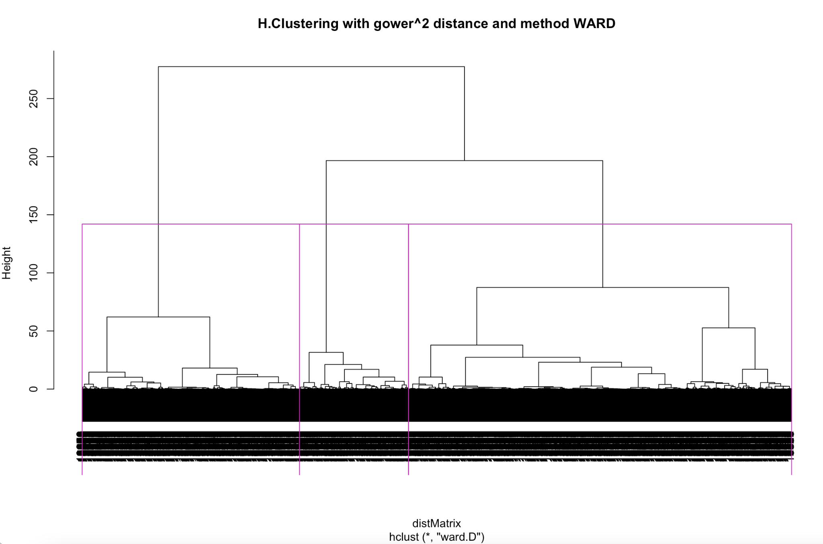
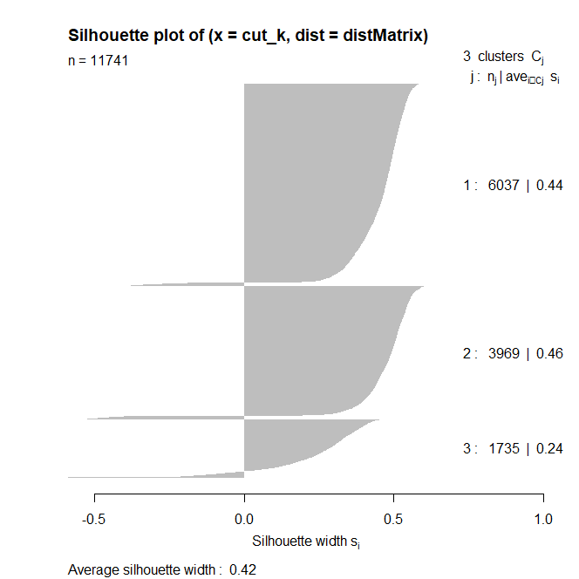
Dendrogram and Silhouette plot

Slide 11
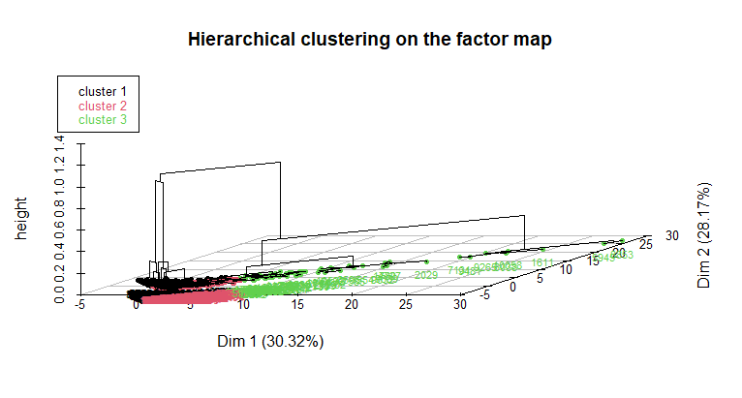
Dendrogram with HCPC

Slide 12
04
Profiling

Slide 13
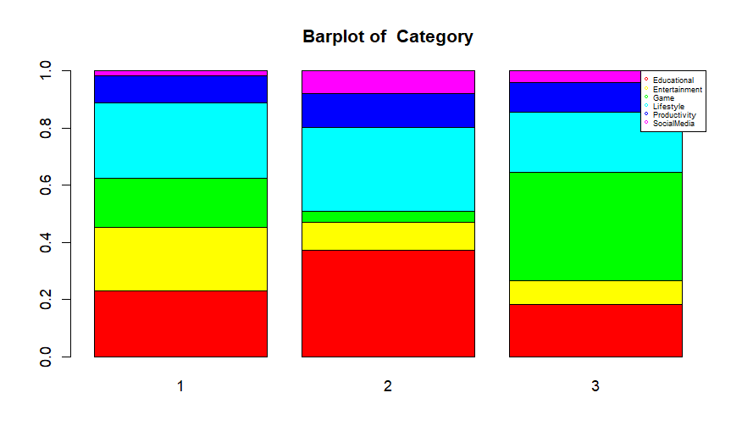
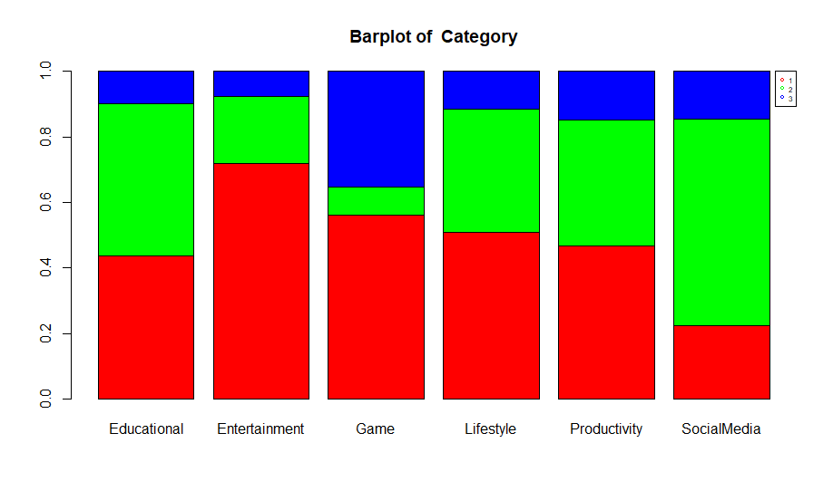
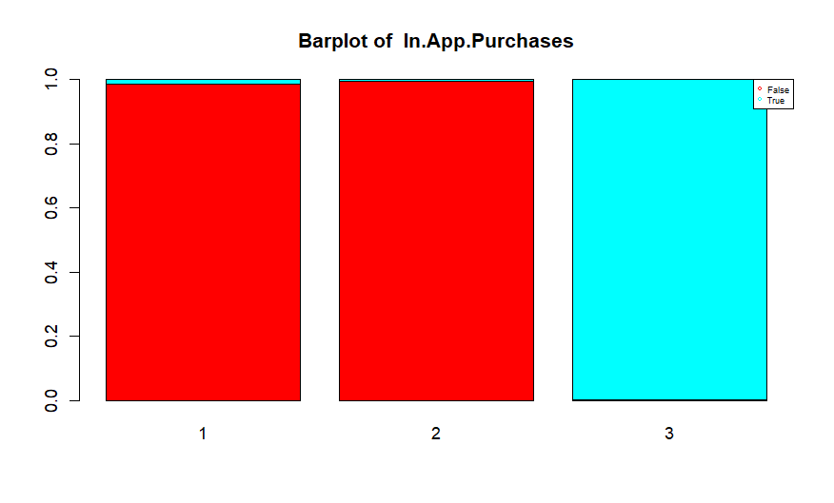
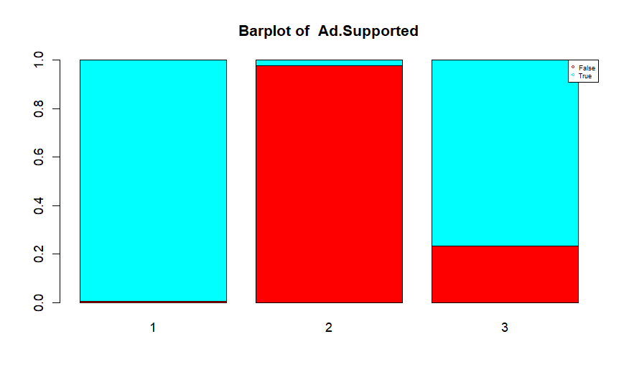
Selection of relevant categorical variables

Slide 14
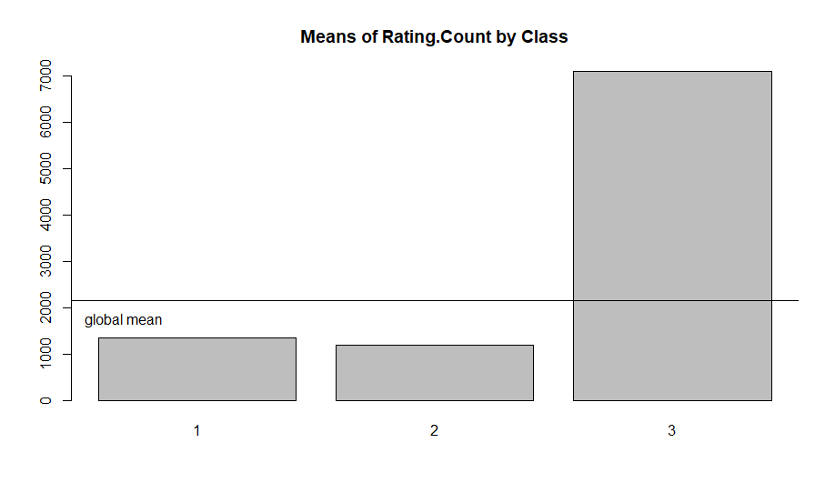
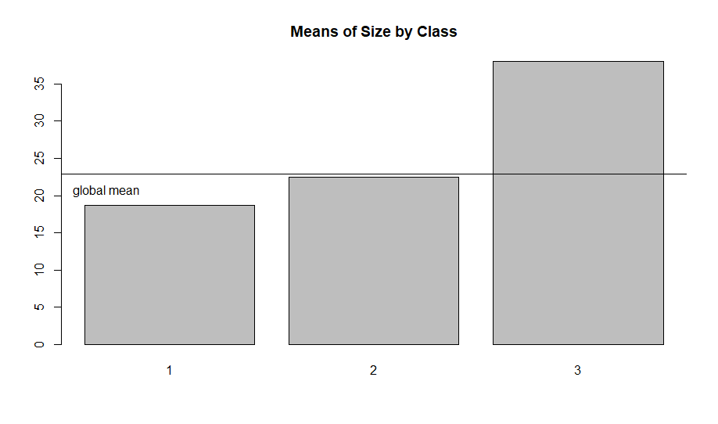
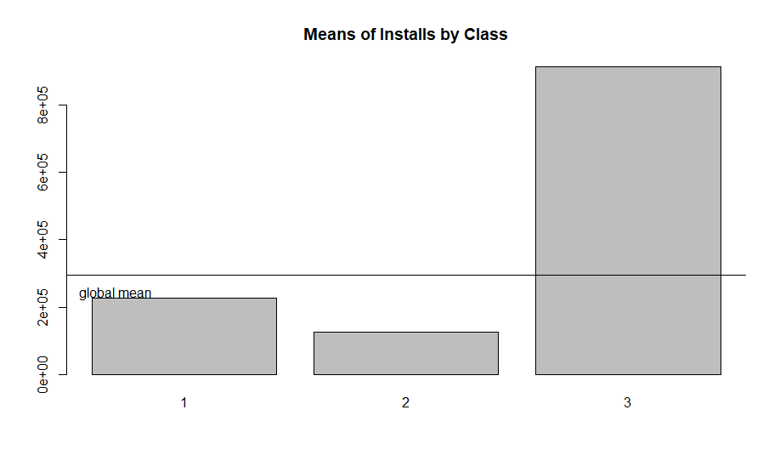
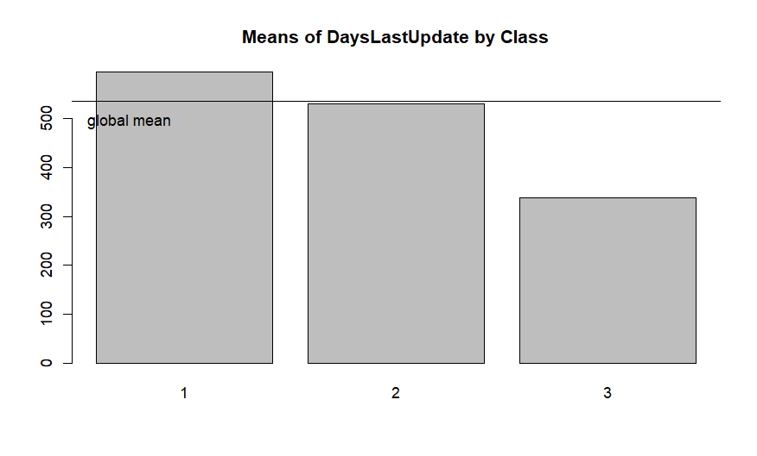
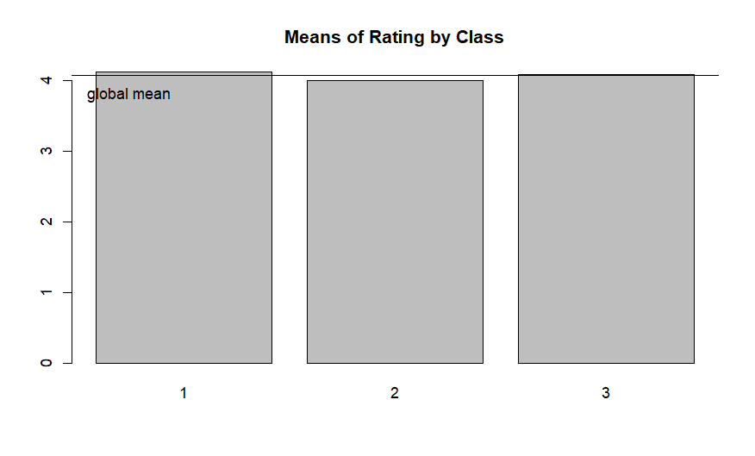
Selection of relevant numerical variables

Slide 15

Profiling of clusters
Cluster 1: Lifestyle, Entertainment & Educational
Cluster 2: Lifestyle & Educational, short names
Cluster 3: Games
Cluster 1 2 3
Rating.Count
Size
Installs
DaysLastUpdate
Ads
In-app Purchases

Slide 16
05
Decision Trees

Slide 17

Approaches
4 classes
Balance Data
Classification
3 classes
2 classes
Generate Model
Decision Tree
Random Forest
Regression

Slide 18
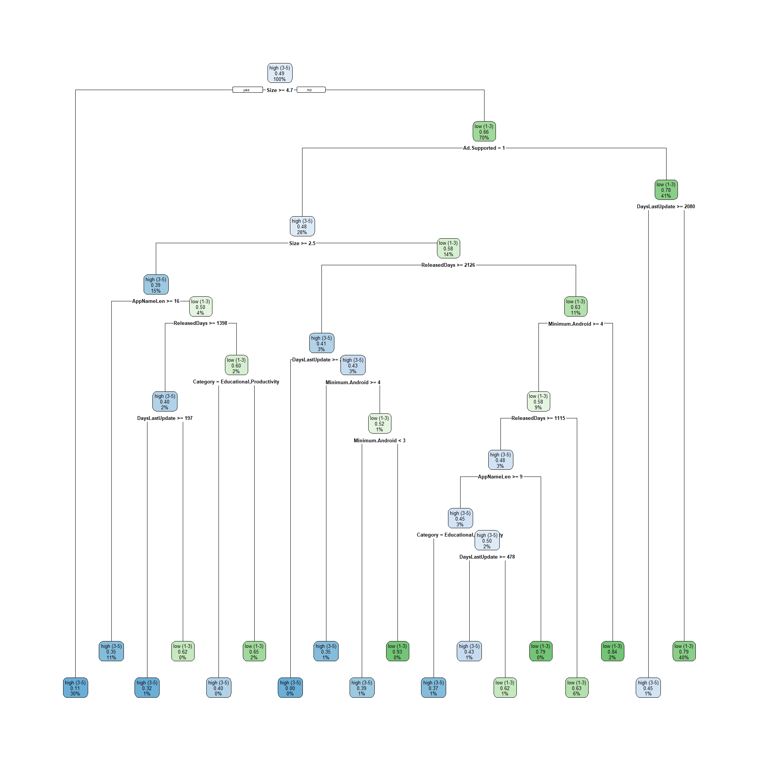
Decision tree
MAIN RULES
Rule 1:
IF size >= 4.7
THEN rating = high
Rule 2:
IF size < 4.7 && ad.Supported != 1 && DaysLastUpdate < 2080
THEN rating = low
ELSE rating = high
Rule 3:
IF size < 4.7 && ad.Supported = 1 && Size >= 2.5 && AppNameLen >= 16
THEN rating = high

Slide 19
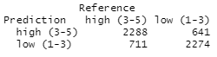
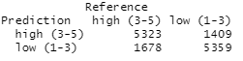
Model Evaluation
CONFUSION MATRIX
77% ACCURACY
74% RECALL
79.5% PRECISION
Testing
Training

Slide 20
06
Discriminant Analysis

Slide 21
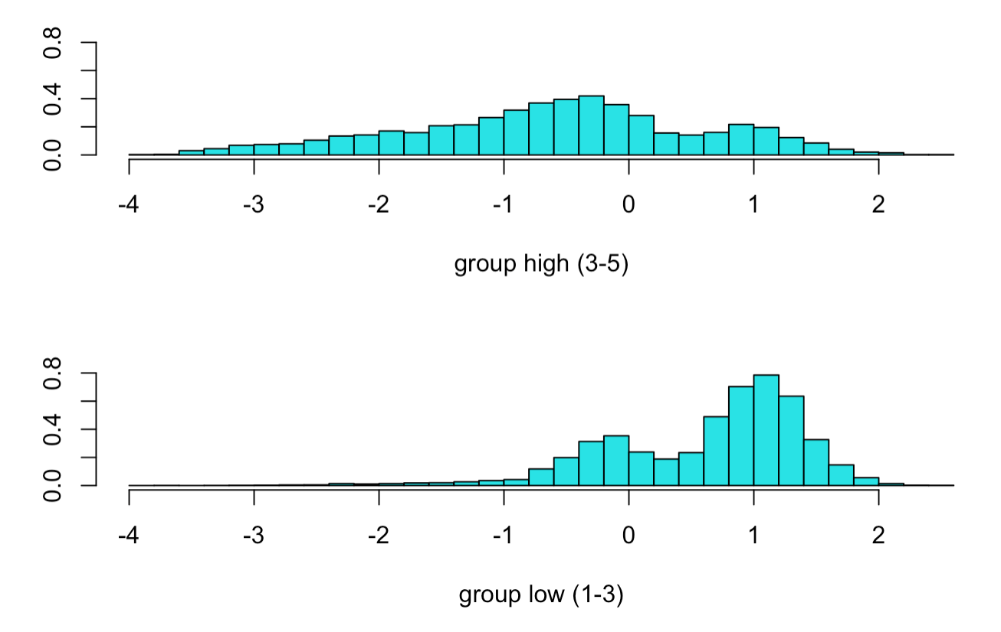
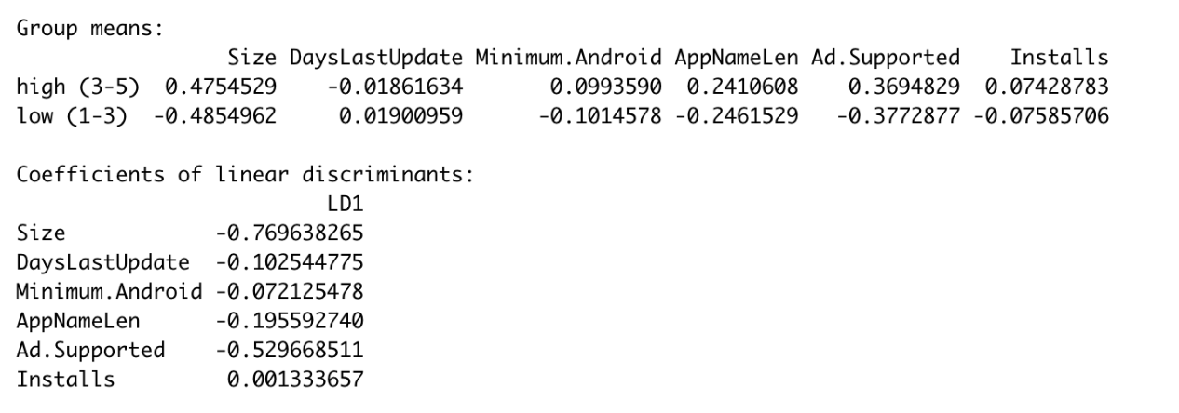
LDA

Slide 22
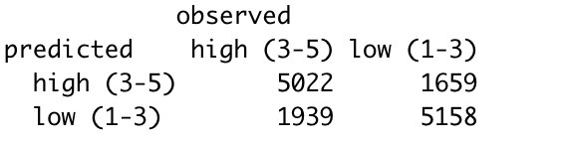
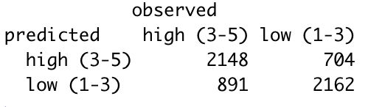
Evaluation
Training
Accuracy: 74%
Misclassification rate: 26%
Testing
Accuracy: 73%
Misclassification rate: 27%

Slide 23
07
Conclusions

Slide 24
Conclusions
The rating of an app is determined by:
Size :: high size → high rating
Supports ads :: ad supported → high rating
Days last update :: less days → low rating
Name Length :: long name → high rating
Future analysis
Categories games or lifestyle
Limit time range of apps
Installs as response variable
Analyze non-free apps & exceptional apps

Slide 25
Thank you for your attention

